Slide 1

The Mars Archive
The Salty Farmers: Vengeance
Allen Kinzalow - Software Engineering, Senior
Haven Barnes - Software Engineering, Junior
Jonathan Hart - Software Engineering, Graduate

Slide 2
Our Goals
Solve the problem statement by creating a unique visual experience that can be accessed from any device
Leverage additional data sources for an additional feature: 3D Mars / Rover Models
Cache data whenever possible

Slide 3
Our Solution
Two components -> One single, consistent experience across platforms:
Web Application: Built in Node.js, leverages Three.js library for 3D modeling of Mars and Rovers
Mobile Application: Built in Swift, a native iOS App that takes advantage of iOS 10’s Scene Kit for Mars model

Slide 4



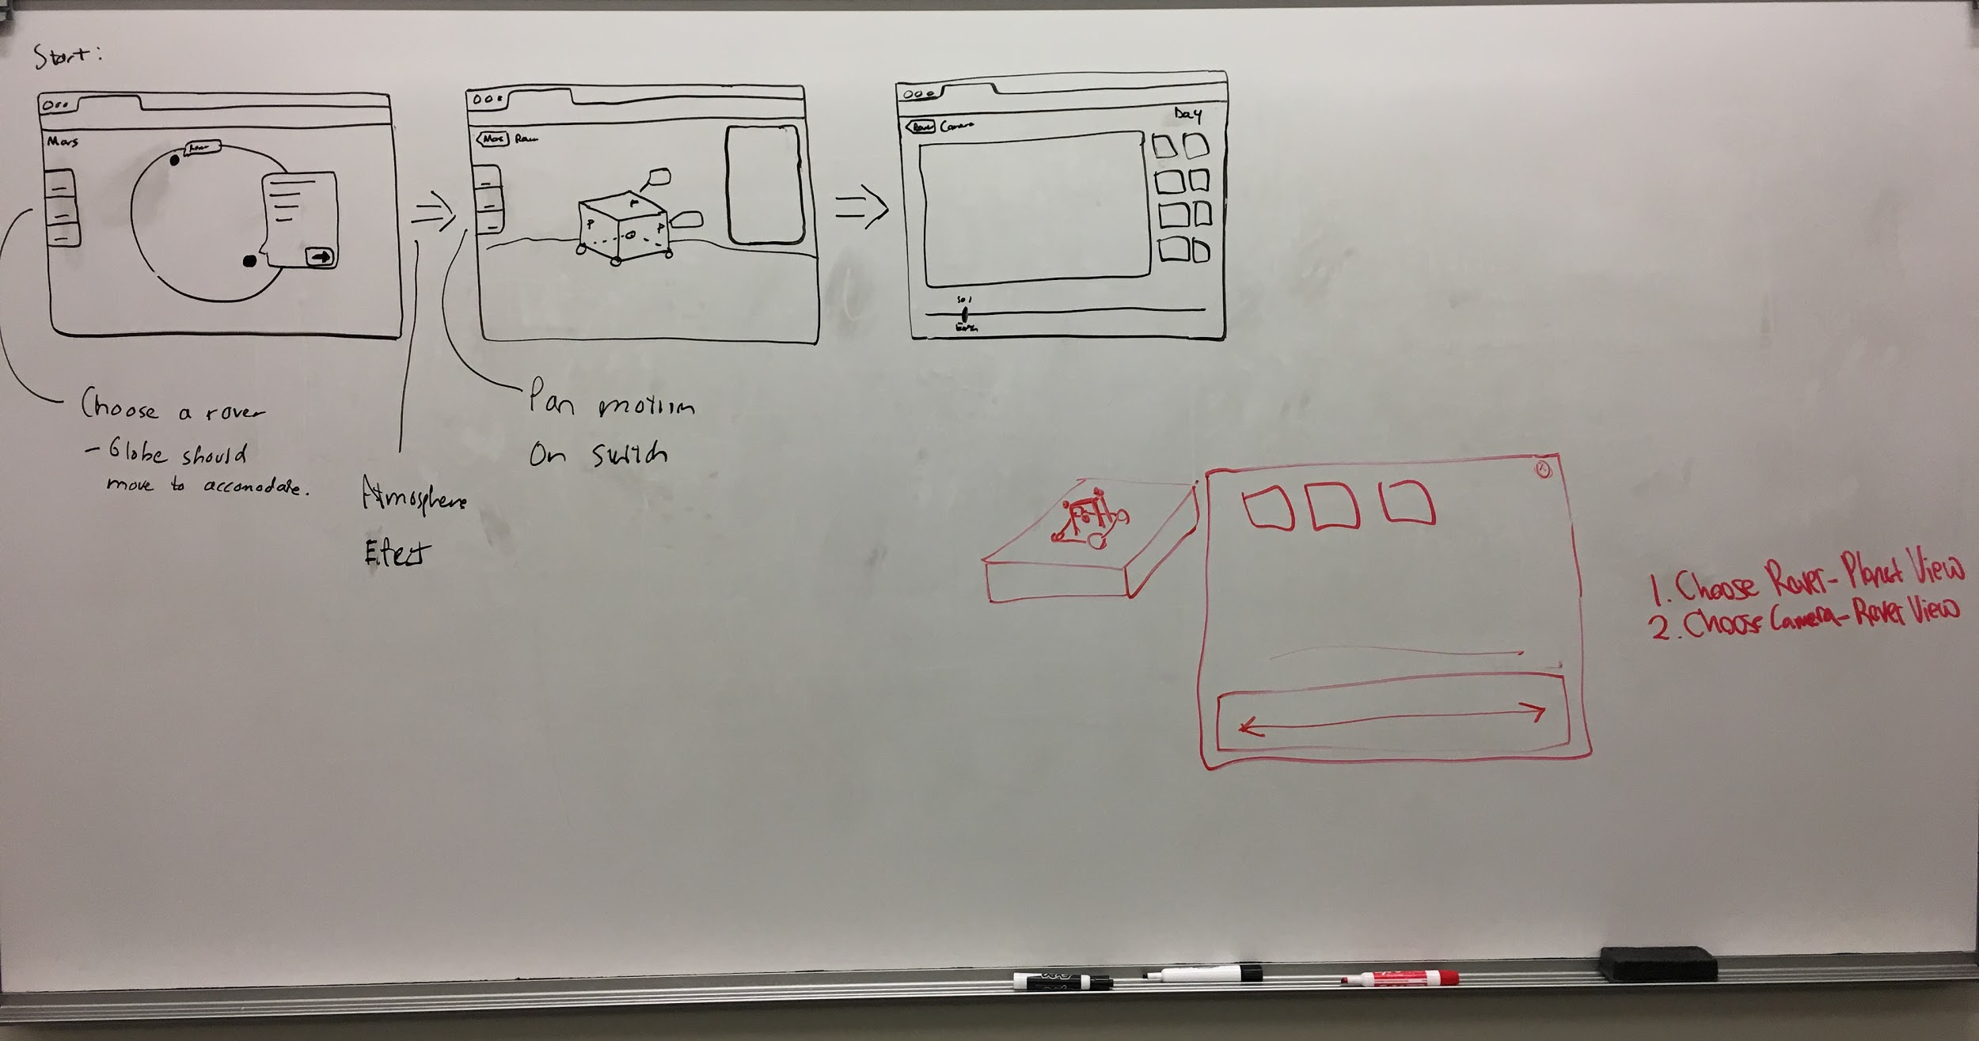
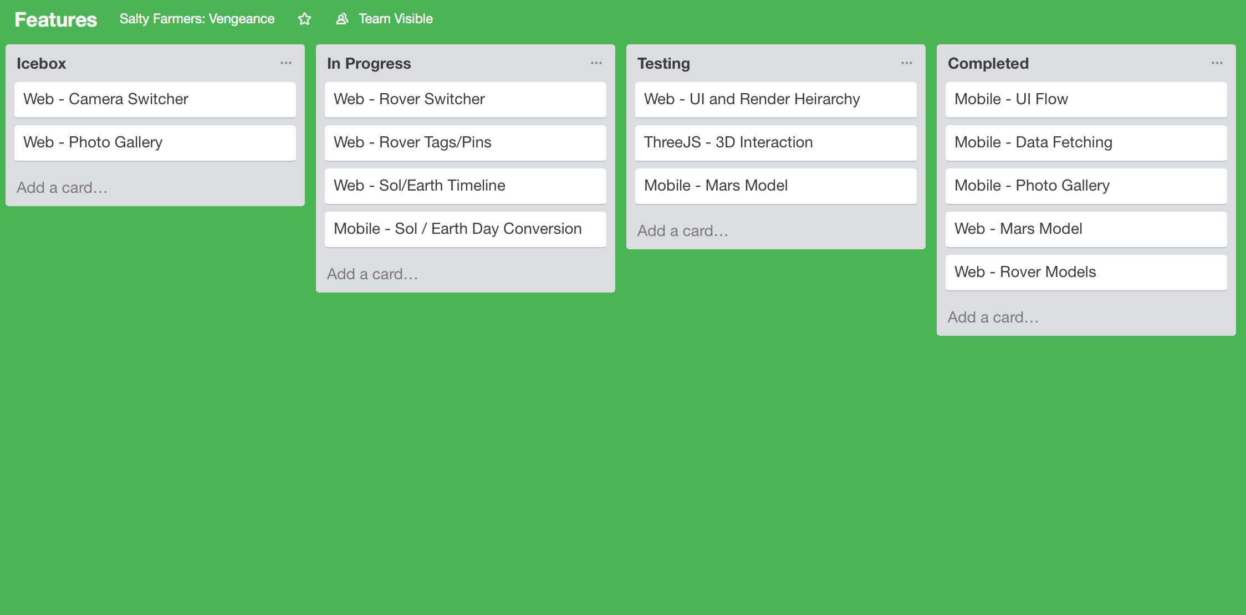
Planning / Teamwork
Tools Used: Gitlab Team, Trello, all with integrations into Slack Team
Insert Board Picture Here

Slide 5
Efficiency Strategies
Under the pressure of time, we came up with a few ground rules to guarantee MAXIMUM team efficiency:
No fluids = No bathroom breaks = More overall coding time
Two 1-hour napping breaks allowed
Only instrumental music (lyrics are distracting)
No outside contact, not even your mother

Slide 6
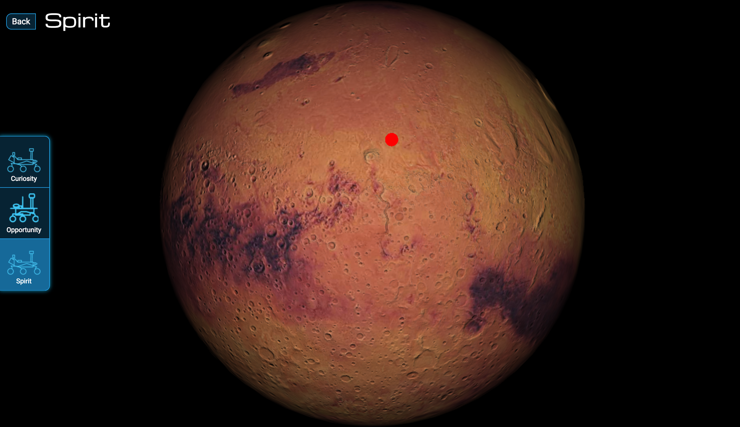
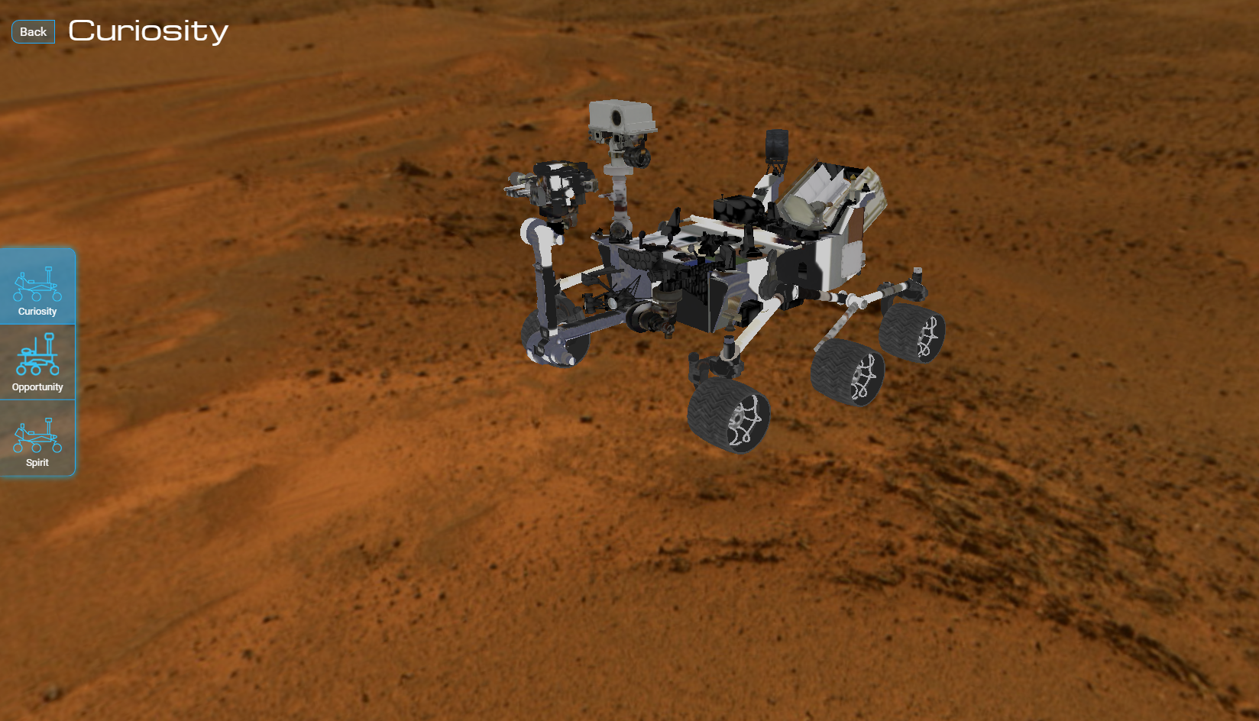
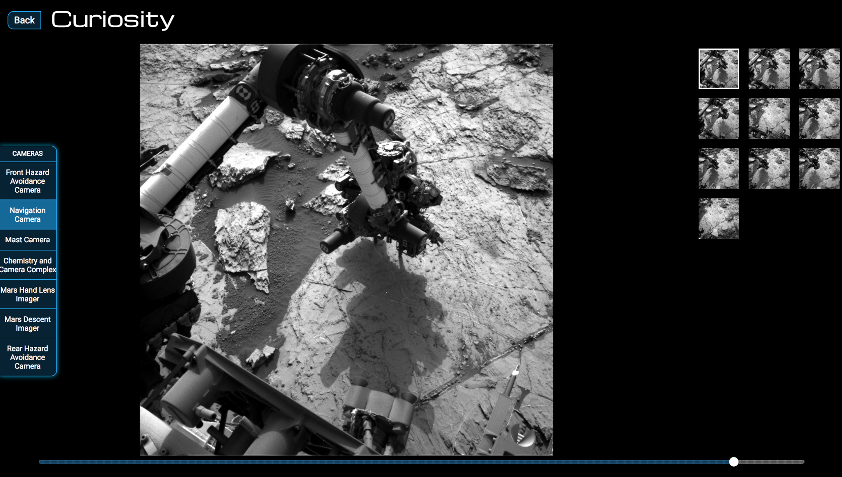
The Web App
Built on Vue.js and Vuex for state management
Used Three.js for 3D Rendering of Mars and Rovers
Used Proxy Server to get around CORS

Slide 7
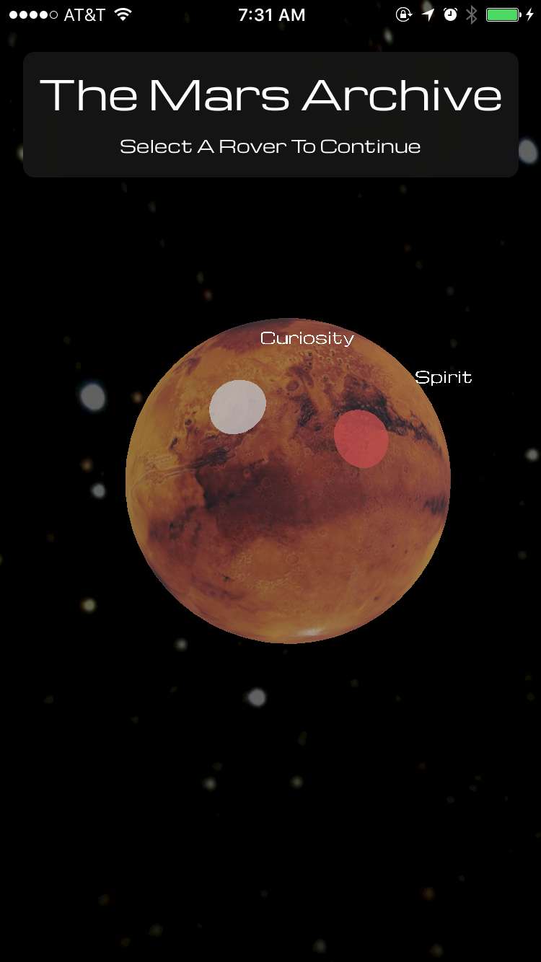
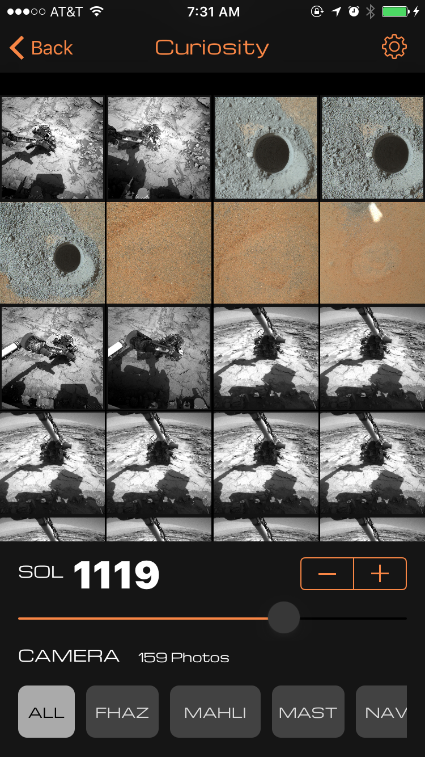
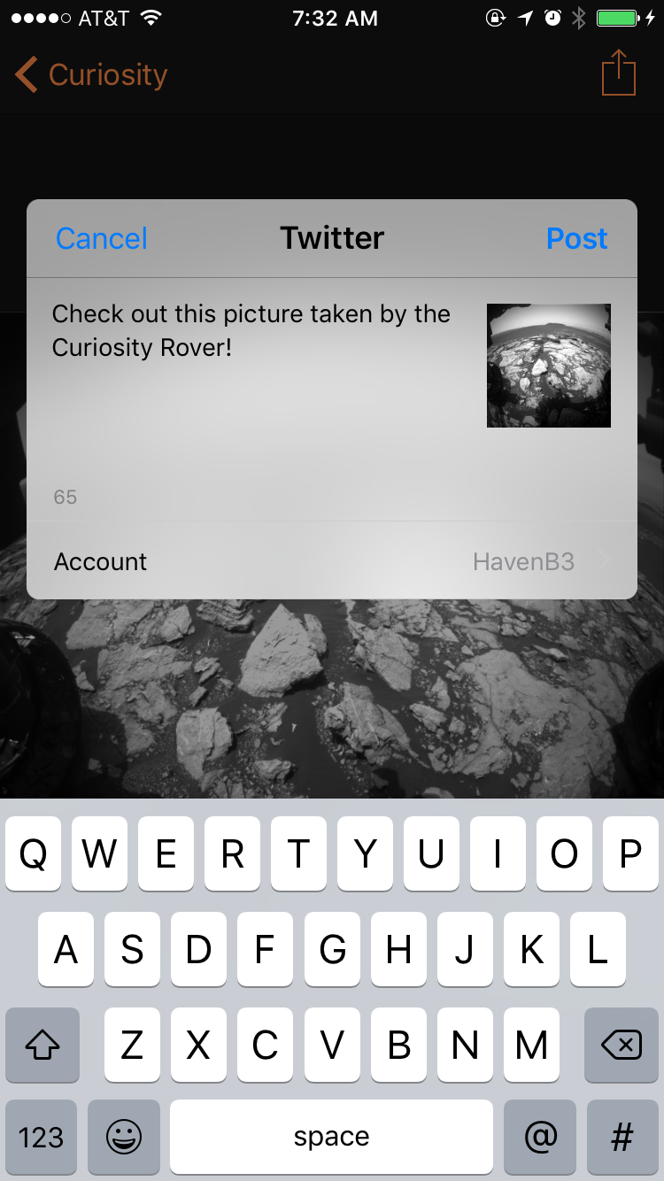
The iOS App
3D Physics-based Mars Model using SceneKit
Image Caching
Intuitive Filtering / Day Selection Options
Full Screen Gallery w/ Zoom
Share Actions

Slide 8
Difficulties Faced
CORS
API Limitations
Frameworks
3D Modeling / Global Positioning
Ever-expanding project requirements

